Slide 1
AZ-900T01 Module 03: Security, privacy, compliance, and trust

Slide 2
Lesson 01: Learning objectives

Slide 3
Module 3 – Learning objectives
Understand and describe :
how to secure network connectivity in Microsoft Azure.
core Azure identity services.
Azure security tools and features.
Azure governance methodologies.
monitoring and reporting in Azure.
privacy, compliance, and data protection standards in Azure.

Slide 4
Lesson 02: Securing network connectivity in Azure

Slide 5
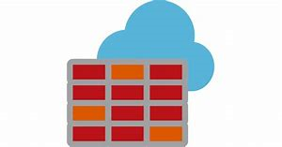
Azure Firewall
Stateful, managed, Firewall as a Service (FaaS) that grants/ denies server access based on originating IP address, to protect network resources.
Azure Firewall features :
applies inbound and outbound traffic filtering rules.
built-in high availability.
unrestricted cloud scalability.
uses Azure Monitor logging.
Notes:
Common Usage Scenarios - You typically deploy Azure Firewall on a central virtual network, to control general network access. With Azure Firewall you can configure:
Application rules that define Fully Qualified Domain Names (FQDNs) which can be accessed from a subnet.
Network rules based on source address, protocol, destination port, and destination address.
Azure Application Gateway also provides a firewall, called the Web Application Firewall (WAF). WAF is different to Azure Firewall. WAF protects your web applications from common exploits and vulnerabilities, whereas Azure Firewall provides:
Inbound protection for non-HTTP/S protocols, such as File Transfer Protocol (FTP) and Secure Shell (SSH).
Outbound network-level protection for all ports and protocols.
Application-level protection for outbound HTTP/S.
The distinct features and functions of Azure Firewall make it suited to different use cases than WAF.
For details, see : https://azure.microsoft.com/en-us/services/azure-firewall/

Slide 6
Walkthrough-Implement an Azure Firewall using Azure Portal
In this walkthrough, you create two virtual machines (VMs). One VM simulates running a workload. The other VM acts as a jump server, which connects to your workload server. You create an Azure Firewall, and route all traffic from your workload server through the Azure Firewall. Then, you create rules in Azure Firewall to allow access to a particular website.
Finish this walkthrough task by completing the steps that follow, or by reading through them.
Notes:
During or after class : students can read through these walkthrough tasks or complete the actual walkthrough steps, like a lab task. Students may complete this walkthrough at the end of:
the module, together with all or some of the other walkthroughs from this module - like an end of module lab.
the course, together with all or some of the other walkthroughs from the overall course - like an end of course lab.
Alternatively, MCTs may step through the walkthrough as a demo for students.

Slide 7
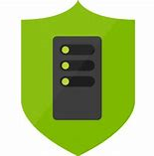
Azure Distributed Denial of Service (DDoS) protection
DDoS attacks overwhelm and exhaust network resources, making apps slow or unresponsive.
Azure DDoS Protection features :
sanitizes unwanted network traffic, before it impacts service availability.
basic service tier is automatically enabled in Azure.
standard service tier adds mitigation capabilities, tuned to protect Azure Virtual Network resources.
Notes:
Azure DDoS standard protection mitigates against the following attacks:
Volumetric attacks – Aims to flood the network layer with high volumes of seemingly legitimate traffic.
Protocol attacks - Render network targets inaccessible by exploiting weaknesses in the layer 3 and layer 4 protocol stack.
Resource (application) layer attacks - Target web application packets to disrupt the data transmission between hosts.
For details about Azure DDoS Protection, see : https://azure.microsoft.com/en-us/services/ddos-protection/

Slide 8

Network security groups (NSGs)
Filters network traffic to, and from, Azure resources on Azure Virtual Networks.
Network security group features :
set inbound and outbound rules to filter by source and destination IP address, port, and protocol.
add multiple rules, as needed, within subscription limits.
Azure applies default, baseline, security rules to new NSGs.
override default rules with new, higher priority, rules.
Notes:
NSG rules have the following properties:
Name : Unique NSG name.
Priority : A number between 100 and 4096. Rules are processed in order of priority; lower numbers are processed before higher numbers.
Source or Destination : Apply the rule to an individual IP address or IP address range, service tag, or application security group.
Protocol : Specifies a network protocol for the rule (can be TCP, UDP, or Any).
Direction : Applies the rule to either inbound or outbound traffic.
Port Range : Enforces the rule on a specific port or range of ports.
Action : Sets the rule to either allow or deny traffic.
For details about NSG, see : https://docs.microsoft.com/en-us/azure/virtual-network/security-overview#network-security-groups

Slide 9
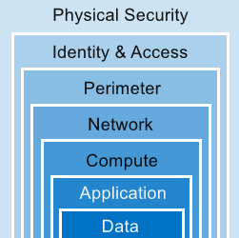
Defense in Depth
A layered approach to securing computer systems.
Provides multiple levels of protection.
Attacks against one layer are isolated from subsequent layers.
Notes:
This high level, conceptual overview explains how security options can be configured to provide protection at each layer. The next slide describes two of the layers in (some) detail.

Slide 10
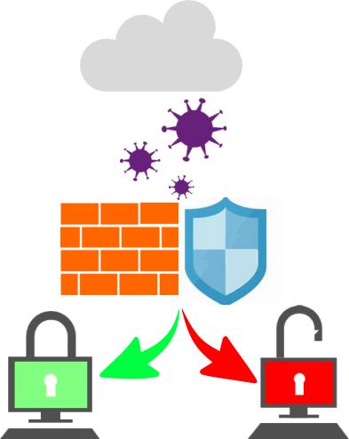
Choosing Azure network security solutions
Perimeter layer : protect your networks’ boundaries with Azure DDoS Protection and Azure Firewall.
Networking layer : only permitted traffic should pass between networked resources with Network Security Group (NSG) inbound and outbound rules.
Azure supports combined network security solutions. For example, NSGs with Azure Firewall; Web Application Firewall (WAF) with Azure Firewall.
Notes:
The previous slide outlined “the defense in depth” layered approach. This slide uses the Perimeter and Networking layers as examples. Discussing Azure networking security solutions at each layer is beyond the scope of this course.
Combining services :
Azure Firewall complements the functionality of Azure Network Security Groups (NSG). Together, they provide robust “defense in depth” network security. Network Security Groups add distributed, network layer, traffic filtering to protect traffic between resources, on virtual networks, within an Azure subscription.
Azure Firewall is a fully stateful, centralized, network Firewall-as-a-Service, which provides network and application-level protection across different subscriptions and virtual networks.
WAF is a feature of Application Gateway. It provides web applications with centralized, inbound, protection against exploits and vulnerabilities. Combining WAF with Azure Firewall adds layers of protection. Azure Firewall provides
inbound protection for non-HTTP/S protocols (for example, RDP, SSH, FTP).
outbound network-level protection for all ports and protocols.
application-level protection for outbound HTTP/S.

Slide 11
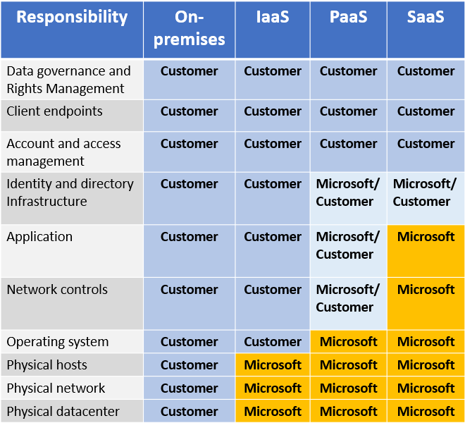
Shared responsibility
Migrating from customer-controlled to cloud-based data centers shifts the responsibility for security.
Security becomes a shared concern between cloud providers and customers.

Slide 12
Lesson 03: Core Azure identity services

Slide 13
Authentication and authorization
Two concepts are fundamental to understanding identity and access.
Authentication
identifies the person or service seeking access to a resource.
requests legitimate access credentials.
basis for creating secure identity and access control principles.
Authorization
determines an authenticated person’s or service’s level of access.
defines which data they can access, and what they can do with it.
Notes:
Note : Authentication is sometimes shortened to AuthN, and authorization is sometimes shortened to AuthZ.

Slide 14

Azure Active Directory (AD)
Microsoft Azure’s cloud-based identity and access management service.
Services provided by Azure AD include :
authentication (employees sign-in to access resources)
single sign-on (SSO)
application management
Business to Business (B2B) and Business to Customer (B2C) identity services
Notes:
Examples of Azure AD services:
Authentication – Adds functionalities such as: self-service user-password reset; multi-factor authentication (MFA); customized banned password lists; smart lockout services.
Single-Sign-On (SSO) - Users only need one ID and password to access multiple applications.
Application management - Manage cloud and on-premises apps using Azure AD’s Application Proxy, SSO, SaaS apps, and My Apps portal (also referred to as Access panel).
Business to Business (B2B) identity services - Manage user credentials for guests and external partners, while retaining control over internal user accounts.
Business to Customer (B2C) identity services – Add services that allow you to customize and control how users of your application sign up, sign in, and manage their user profiles. Includes integrated social identity, sign in experiences.
For details about Azure AD, see : https://azure.microsoft.com/en-us/services/active-directory/

Slide 15
Azure Multi-Factor Authentication (MFA)
Multiple step verification process to safeguard access to data and applications, while maintaining simplicity for users.
To gain access, users must supply two (or more) of the following :
something they know : password or answer to a security question.
something they possess : email verification code, mobile app that receives a notification, or a token-generating device.
something they are : biometric property, such as a fingerprint or face scan.
Notes:
Multi-Factor Authentication (MFA) is part of the following Azure services:
Azure Active Directory Premium licenses - These licenses provide fully-featured use of the Azure MFA Service (cloud) or Azure MFA Server (on-premises).
Multi-Factor Authentication for Office 365 - A subset of Azure MFA capabilities are available as a part of your Office 365 subscription.
Azure Active Directory global administrators - Because global administrator accounts are highly sensitive, a subset of Azure MFA capabilities are available for protecting these accounts.
For details about Azure MFA, see : https://docs.microsoft.com/en-us/azure/active-directory/authentication/concept-mfa-howitworks

Slide 16
Lesson 04: Security tools and features

Slide 17

Azure Security Center
A monitoring service that provides threat protection across all your Azure, and on-premises, services.
Azure Security Center features :
provides security recommendations based on your configurations, resources, and networks.
monitors security settings across your on-premises and cloud workloads.
automatically applies your security policies to any new services you provision.
Notes:
Azure Security Center is part of the Center for Internet Security’s (CIS) benchmark recommendations : https://www.cisecurity.org/cis-benchmarks/
Azure Security Center versions
Azure Security Center is available in Free and Standard tiers:
Free tier - Available as part of your Azure subscription, this tier is limited to assessments and recommendations of Azure resources only.
Standard tier - Provides a full suite of security-related services, including: continuous monitoring, threat detection, just-in-time access control for ports.
To access the full suite of Azure Security Center services, upgrade to a Standard tier subscription. A 60-day free trial is accessible from the Azure Security Center dashboard in Azure Portal.
For details about Azure Security Center, see : https://azure.microsoft.com/en-us/services/security-center/

Slide 18
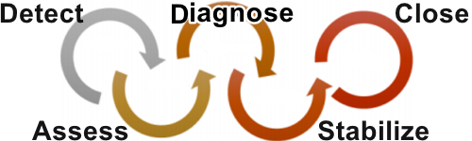
Azure Security Center usage scenarios
Use Azure Security Center in the Detect, Assess, and Diagnose stages of an incident response.
Apply Azure Security Center recommendations to enhance security.
Notes:
Azure Security Center can be useful during three of the incident response stages:
Detect - Review the first indication of suspicious activity. For example, the Security Center dashboard may indicate that a high-priority security alert was raised.
Assess - Perform an assessment to obtain information about the suspicious activity. For example, get details from Security Center about the security alert and why it was raised.
Diagnose - Conduct a technical investigation and identify containment, mitigation, and workaround strategies. For example, follow the remediation steps described by Security Center in response to a particular security alert.
Applying Security Center recommendations can also enhance security.
You can reduce the chances of encountering a significant security event by configuring a security policy, and by implementing the recommendations provided by Azure Security Center.
A security policy defines a set of controls for resources within a subscription or resource group. In Security Center, you define policies according to your security requirements.
Security Center analyzes the security state of your Azure resources. When Security Center identifies potential security vulnerabilities, it creates recommendations based on the controls that you set in your security policies. The recommendations guide you through (re)configuring your security controls. Azure Security Center may recommend that you turn off unnecessary security policies that are enacted upon resources that do not require them. For example: “Your workloads do not require the Azure SQL Database Transparent Data Encryption (TDE) policy, turn off the policy at the subscription level and enable it only in the resources groups where SQL TDE is required.”
For details about Azure Security Center, see : https://azure.microsoft.com/en-us/services/security-center/

Slide 19

Azure Key Vault
Stores application secrets in a centralized cloud location, to securely control access permissions, and access logging.
Use Azure Key Vault for :
secrets management.
key management.
certificate management.
storing secrets backed by hardware security modules (HSMs).
Notes:
The benefits to using Azure Key Vault include:
Centralized application secrets - Centralizing storage for application secrets allows you to control their distribution, and reduces the chances that secrets may be leaked accidentally.
Securely stored secrets and keys - Azure uses industry-standard encryption algorithms, key lengths, and HSMs. Proper authentication and authorization is required to access secrets and key.
Monitor access and use – With Azure Key Vault, you can monitor and control access to company secrets.
Simplified administration of application secrets - Enroll and renew certificates from public certificate authorities (CAs). Scale up and replicate content within regions. Manage application secrets with standard management tools.
Integrate with other Azure services - Integrate Azure Key Vault with storage accounts, container registries, event hubs, and many other Azure services.
For details about Azure Key Vault, see : https://azure.microsoft.com/en-us/services/key-vault/ webpage.

Slide 20
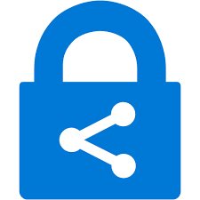
Azure Information Protection (AIP)
Classifies and protects documents, and emails, by applying labels.
AIP labels can be applied :
automatically using rules and conditions defined by administrators.
manually, by users.
by combining automatic and manual methods, guided by recommendations.
Notes:
Azure Information Protection (AIP) usage scenario :
A user saves a Microsoft Word document that contains a credit card number.
A custom tooltip notification is displayed to the user that recommends labelling the document as “Confidential\ All Employees”.
This label classifies the document file and protects it.
The recommended label, and the rules for screening and protecting documents, are pre-configured by an administrator.
AIP can be purchased either as standalone, or through Microsoft licensing suites (Enterprise Mobility + Security, or Microsoft 365 Enterprise). For purchasing details, see : https://azure.microsoft.com/en-us/pricing/details/information-protection/
For general information about Microsoft AIP, see : https://docs.microsoft.com/en-us/azure/information-protection/what-is-information-protection

Slide 21
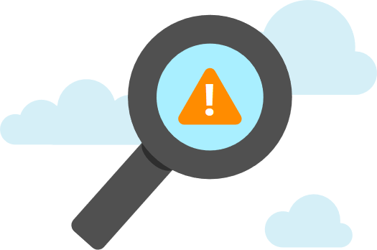
Azure Advanced Threat Protection (Azure ATP)
Cloud-based security solution for identifying, detecting, and investigating advanced threats, compromised identities, and malicious insider actions.
Consists of Azure ATP :
Portal : dedicated portal for monitoring and responding to suspicious activity.
Sensors : installed directly onto your domain controllers.
Cloud service : runs on Azure infrastructure.
Notes:
Purchasing Azure ATP - Azure ATP is not available to purchase via Azure Portal, but it is available:
as a standalone license
as part of an Enterprise Mobility + Security 5 suite (EMS E5) license
through the Cloud Solution Provider (CSP) licensing model
Via direct licensing at : https://www.microsoft.com/en-ie/cloud-platform/enterprise-mobility-security-pricing
Access Azure ATP Portal at https://portal.atp.azure.com and select your instance, OR browse to your instance URL: https://instancename.atp.azure.com.
Only users assigned to an Azure Active Directory Security Group can log into Azure ATP Portal.
For details about Azure ATP, see : https://azure.microsoft.com/en-us/features/azure-advanced-threat-protection/

Slide 22
Lesson 05: Azure governance methodologies

Slide 23

Azure Policy
Stay compliant with your corporate standards and service level agreements (SLAs) by using policy definitions to enforce rules and effects for your Azure resources.
Azure Policy features :
evaluates and identifies Azure resources that do not comply with your policies.
provides built-in policy and initiative definitions, under categories such as Storage, Networking, Compute, Security Center, and Monitoring.
Notes:
Azure Policy can integrate with Azure DevOps to apply policies for your Continuous Integration and Delivery Pipelines (for the pre- and post-deployment of your apps).
Azure Policy can remediate non-compliant resources and configurations automatically, to help maintain the state of your resources.
For details about Azure Policy, see : https://azure.microsoft.com/en-us/services/azure-policy

Slide 24
Policies : Example policy definitions
Allowed Storage Account size
conditions and rules define acceptable sizes for new storage accounts.
requests to create storage accounts outside the defined sizes are denied.
Allowed Locations
defines the Azure locations where your organization can deploy resources, to enforce geographic compliance requirements.
requests to deploy resources outside the defined locations are denied.
More Azure Policy examples :
docs.microsoft.com/azure/governance/policy/samples/
Notes:
Apply a policy to your resources in three steps:
Create the policy definition.
Assign the definition to a scope of resources.
View the policy evaluation results.
Additional policy definition example : Allowed Virtual Machine (VM) SKUs - This policy specifies a set of VM SKUs that your organization can deploy.
Consider browsing to the Azure Policy examples page, and scrolling through some of the sample policies.
Policy assignment : To implement a policy definition, you must assign them first. A policy assignment is a policy definition that has been assigned to a specific scope. This scope could range over a management group or a resource group. Policy assignments are inherited by all child resources.
For details about Azure Policy, see : https://azure.microsoft.com/en-us/services/azure-policy/

Slide 25
Initiatives
Initiatives work alongside policies in Azure Policy.
Initiative definitions : Group multiple policy definitions into a single unit, to track compliance at greater/ macro-level scope.
For example, one initiative can monitor all of your Azure Security Center recommendations.
Initiative assignments : Initiative definitions that are assigned to a specific scope. Initiative assignments reduce the need to make an initiative definition for each scope.
Notes:
Even if you have a single policy, we recommend using initiatives if you anticipate adding more policies over time.
Initiative definitions - Simplify the process of managing and assigning policy definitions, by grouping a set of policies into one single item. For example, you could create an initiative named Enable Monitoring in Azure Security Center, for the purpose of monitoring all the available security recommendations in your Azure Security Center.
Under this initiative, you would have the following policy definitions:
Monitor unencrypted SQL Database in Security Center – For monitoring unencrypted SQL databases and servers.
Monitor OS vulnerabilities in Security Center – For monitoring servers that do not satisfy the configured baseline.
Monitor missing Endpoint Protection in Security Center – For monitoring servers without an installed endpoint protection agent.
Initiative assignments - Like a policy assignment, an initiative assignment is an initiative definition assigned to a specific scope. Initiative assignments reduce the need to make several initiative definitions for each scope. Scope could also range from a Management Group to a Resource Group.

Slide 26

Role-based access control (RBAC)
Fine-grained access management control over your Azure resources.
Available to all Azure subscribers, at no additional cost.
Example uses of Azure RBAC :
Grant specific access rights to particular users for certain jobs. One user can manage VMs, while another manages virtual networks.
Allocate particular database types to certain database administration groups.
Notes:
Another example use of RBAC is allocating management control over all resources in a resource group to a specific user.
Consider demonstrating Azure RBAC in Azure Portal to students. To view access permissions :
Open the Access Control (IAM) blade in Azure portal.
View access permissions assigned to a resource, by user and by role.
Grant or remove access to specific users/ groups.
RBAC best practices :
Segregate duties by team.
Grant users the least privileges necessary to perform their jobs.
Restrict permissions to only allow certain actions at a particular scope.
Plan your access control strategies carefully.
For details about Azure RBAC, see : https://docs.microsoft.com/en-us/azure/role-based-access-control/overview

Slide 27
Locks
Protect your Azure resources from accidental deletion or modification .
Manage locks at subscription, resource group, or individual resource levels within Azure Portal.
 | User Actions
Lock Types | Read | Update | Delete
CanNotDelete | Yes | Yes | No
ReadOnly | Yes | No | No
Notes:
Consider showing students “Locks” in Azure Portal.
In Azure portal, the lock types are called Delete and Read-only.
For details about Locks, see : https://docs.microsoft.com/en-us/azure/azure-resource-manager/resource-group-lock-resources

Slide 28

Azure Advisor security assistance
Get personalized advice and recommendations to improve and enhance security.
Integrates with Azure Security Center to provide in-depth security recommendations.
View recommendations in the Azure Advisor dashboard.
Notes:
Azure Advisor provides security recommendations by integrating with Azure Security Center. Personalized security recommendations are visible on the Security tab of the Azure Advisor dashboard. You can “click into” each recommendation for greater detail.
For details about Azure Advisor, see : https://docs.microsoft.com/en-us/azure/advisor/advisor-overview

Slide 29
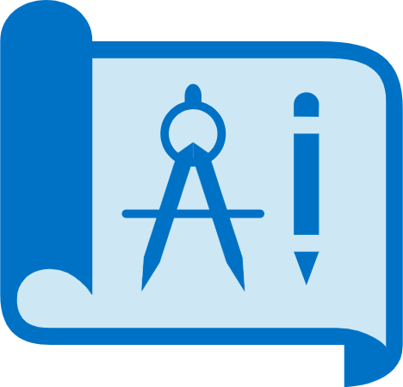
Azure Blueprints
Create reusable environment definitions that can recreate your Azure resources and apply your policies instantly.
Use Azure Blueprints to :
help audit and trace your deployments, and maintain compliance using built-in tools and artifacts.
associate blueprints with specific Azure DevOps build artifacts, and release pipelines, for rigorous tracking.
Notes:
To implement an Azure Blueprint : (a) create the blueprint; (b) assign the blueprint; (c) track the blueprint’s assignments.
Usage scenarios
Adhering to (government and industry) security and compliance requirements is challenging and time-consuming. Azure Blueprints provides artifacts and tools that improve your auditing and traceability capabilities, to maintain compliance across your deployments. Azure Blueprints’ artifacts and tools can reduce the amount of time you spend completing paperwork, and expedite the certification process.
Azure Blueprints can also be used in Azure DevOps scenarios. Associating blueprints with specific build artifacts and release pipelines, means they can be tracked more rigorously.
At the time of writing, Azure Blueprints is in preview and is not in general availability.
For details about Azure Blueprints, see : https://azure.microsoft.com/en-us/services/blueprints/

Slide 30
Lesson 06: Monitoring and reporting in Azure

Slide 31

Azure Monitor
Collect, analyze, and act on telemetry from cloud and on-premises environments, to maximize your applications’ availability and performance.
starts collecting data as soon as you create an Azure subscription and add resources.
Activity Logs record all resource creation and modification events.
Metrics measure resource performance and consumption.
add an Azure monitor agent to collect operational data for a resource.
Notes:
What data does Azure Monitor collect? - Azure Monitor collects data from many sources. The types of data collected by Azure Monitor include (not a full list) :
Application monitoring data : Data about the performance and functionality of the code you have written, regardless of its platform.
Azure resource monitoring data : Data about the operation of an Azure resource.
Azure subscription monitoring data : Data about the operation and management of an Azure subscription, as well as data about the overall health and operation of Azure itself.
Diagnostic settings - As soon as you create an Azure subscription and start adding resources, such as virtual machines and web apps, Azure Monitor starts collecting data.
Activity Logs record when resources are created or modified.
Metrics tell you how a resource is performing, and how much the resource is consuming (for example, network bandwidth consumption, etc.).
You can extend the data you're collecting into the actual operation of a resource. Do this by enabling diagnostics, and adding a monitoring agent to the resource.
For details about Azure Monitor, see : https://azure.microsoft.com/en-us/services/monitor/

Slide 32
Monitoring applications and services
Integrate Azure Monitor with other Azure services to improve your data monitoring capabilities, and gain better insights into your operations.
Analyze | Use variants of Azure Monitor for resources (containers, virtual machines, etc.), with Azure Application Insights for applications.
Respond | Azure Alerts can respond proactively to critical conditions identified in your monitor data, and use Auto-scale with Azure Monitor Metrics.
Visualize | Use Azure Monitor data to create interactive visualizations, charts, and tables with Power BI.
Integrate | Integrate Azure Monitor with other systems to build customized solutions to suit your needs and requirements.
Notes:
Analyze
Azure Application Insights : A service that monitors the availability, performance, and usage of your web applications (hosted, cloud-based, or on-premises).
Azure Monitor for Containers : Monitors the performance of container workloads that are deployed to managed Kubernetes clusters, and not hosted on Azure Kubernetes Service (AKS).
Azure Monitor for VM : Monitors your Azure VMs, at scale, by analyzing their performance and health, processes, dependencies on other resources, and external processes.
Respond - In addition to allowing you to analyze monitoring data interactively, an effective monitoring solution should respond proactively to critical conditions identified in the data that it collects. This might involve sending a text or email alert to the administrator responsible for investigating an issue, or launching an automated process to correct an error condition.
Alerts : Alerts in Azure Monitor notify you of critical conditions proactively, and can be used to implement corrective actions.
Autoscale : Ensures you have the right amount of resources running to manage the workload on your application.
Visualize - Visualizations, such as charts and tables, are effective tools for summarizing monitor data and for presenting it to different audiences. Other tools you can use to visualize data are Dashboards, Views, and Power BI.
Integrate – You may often need to integrate Azure Monitor with other systems, and build custom solutions to use your monitoring data. Other Azure services work well with Azure Monitor to provide these kinds of integrations. For example, integrating monitoring services with Azure Service Health (on the next slide) can add really value.

Slide 33

Azure service health
Evaluate the impact of Azure service issues with personalized guidance and support, notifications, and issue resolution updates.
Components of Azure service health :
Azure Status : provides a global overview Azure services’ state of health.
Service Health : customizable dashboard for tracking the state of services in the regions you use.
Azure Resource Health : diagnose and obtain support for Azure service issues affecting your resources.
Notes:
Together, these components provide comprehensive insights into Azure’s state of health. You can choose the level of granularity that is most relevant to your requirements.
For details about Azure Service Health, see : https://azure.microsoft.com/en-us/services/monitor/

Slide 34
Lesson 07: Privacy, compliance and data protection standards in Azure

Slide 35
Compliance Terms and Requirements
Microsoft’s compliance offerings, certifications, and attestations outnumber those from other cloud service providers.
Compliance offerings include:
Criminal Justice Information Services | Health Insurance Portability and Accountability Act
CSA STAR Certification | ISO/ IEC 27018
General Data Protection Regulation (GDPR) | National Institute of Standards and Technology
View all Microsoft compliance details at :
microsoft.com/trustcenter/compliance/complianceofferings
Notes:
Consider discussing the following topic and questions with students.
When choosing a cloud provider to host your applications, you need to understand how the provider can help you comply with regulations and standards. Questions to consider when selecting a cloud provider include:
How compliant is the cloud provider with requirements for handling sensitive data?
How compliant are the services offered by the cloud provider?
Can the cloud provider offer accreditation to ensure you meet compliance requirements for the cloud-based solutions you deploy?
Microsoft invests heavily in the development of robust and innovative compliance processes.
Consider browsing to the URL on this slide, and briefly scrolling through Microsoft’s compliance offerings.
Acronym explanations :
CSA CSTAR Certification - The Cloud Security Alliance (CSA) maintains the Security, Trust & Assurance Registry (STAR). The STAR registry is a free, publicly accessible registry where cloud service providers publish their CSA assessment results. Cloud service providers are assessed on their adherence to fundamental security principles, in order to help cloud customers assess the security risk of a cloud service.
ISO/ IEC 27018 - International Organization for Standardization (ISO) and the International Electrotechnical Commission (IEC) directive 27018, provides a code of practice for protecting personally identifiable information in public clouds.

Slide 36

Microsoft privacy statement
Provides openness and honesty about how Microsoft handles the user data collected from its products and services.
The Microsoft privacy statement explains :
which data Microsoft process,
how Microsoft processes it,
and for what purposes.
Review Microsoft's Privacy Statement at :
microsoft.com/privacystatement
Notes:
Consider browsing to the URL in this slide, and looking through Microsoft's Privacy Statement with students (briefly).

Slide 37

Trust Center : microsoft.com/trustcenter
Learn about security, privacy, compliance, policies, features, and practices across Microsoft’s cloud products.
Trust Center website provides :
in-depth, expert information.
curated lists of recommended resources, arranged by topic.
role-specific information for business managers, administrators, engineers, risk assessors, privacy officers, legal teams, and more.
Notes:
Consider browsing to the Trust Center website with students.
For more details about Trust Center, see : https://www.microsoft.com/trustcenter

Slide 38

Service Trust Portal (STP) : servicetrust.microsoft.com
A Trust Center companion website for compliance-related publications about Microsoft cloud services. Hosts the Compliance Manager service.
Use STP to access :
audit reports across Microsoft cloud services.
guides to using Microsoft cloud services for regulatory compliance.
publications about trust, and how Microsoft cloud services protect your data.
Notes:
Accessing the STP - To access some STP materials, you must sign-in as an authenticated user with your Microsoft cloud services account (an Azure AD organization account or a Microsoft account). Then, review and accept the Microsoft Non-Disclosure Agreement for Compliance Materials.
Existing customers can access STP at : https://servicetrust.microsoft.com/
with an Office 365, Dynamics 365 or Azure subscription (trial or paid).

Slide 39
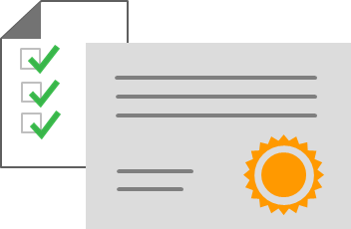
Compliance Manager
Workflow-based, risk assessment tool in Trust Portal that supports your organization's regulatory compliance activities.
Compliance Manager features :
assign, track, and verify your compliance and assessment-related activities.
provides a score by evaluating your compliance status.
stores and manages your compliance-related artifacts in a secure digital repository.
Notes:
Compliance Manager provides ongoing risk assessments for regulations and standards, and provides risk-based scores in a dashboard.
As part of its risk assessments, Compliance Manager provides recommended actions that you can take to improve your regulatory compliance status (please see important note below).
Compliance Manager features (additional features not shown on this slide, are listed last) :
Lets you assign, track, and record your compliance and assessment-related activities. This helps your organization meet its compliance goals.
Provides a Compliance Score to help track your auditing processes and prioritize compliance targets. These additional controls can reduce your organization's exposure to risk.
Provides a secure repository where you can upload, and manage, evidence and artifacts related to your compliance activities.
Produces richly detailed reports for Microsoft Excel that document your compliance activities. You can send the reports to auditors, regulators, and other compliance stakeholders.
Provides access to assessment and compliance-related information about Azure, Office 365, Dynamics 365, and other Microsoft products and services.
IMPORTANT NOTE: Compliance Manager is a dashboard that provides a summary of your data protection and compliance status, as well as recommendations to improve your data protection and compliance status. The Customer Actions provided in Compliance Manager are recommendations only. Each organization must evaluate the effectiveness of these recommendations, in their respective regulatory environment, prior to implementation. Compliance Manager recommendations should not be interpreted as a guarantee of compliance.

Slide 40
Azure government services (USA)
Meets the security and compliance needs of US federal agencies, state and local governments, and their solution providers.
Azure Government :
separate instance of Azure.
physically isolated from non-US government deployments.
accessible to screened, authorized personnel.
Examples of compliant standards : FedRAMP, NIST 800.171 (DIB), ITAR, IRS 1075, DoD L2, L4 & L5, and CJIS.
Notes:
For details about Azure Government, see : https://azure.microsoft.com/en-us/global-infrastructure/government/
Acronym explanations
FedRAMP : US Federal Risk and Authorization Management Program (FedRAMP) is a standardized approach for assessing, monitoring, and authorizing cloud computing products and services under the US Federal Information Security Management Act (FISMA).
NIST 800.171 (DIB) : National Institute of Standards and Technology (NIST) 800.171 standardizes security requirements for handling US Federal controlled unclassified information.
ITAR : International Traffic in Arms Regulations (ITAR) relate to managing the export and import of defense articles.
IRS 1075 : US Internal Revenue Service Publication 1075 contains guidelines for US government agencies to protect Federal tax information.
DoD L2, L4 & L5 : US Department of Defense (DoD) Levels 2, 4, and 5 are security authorization requirements for cloud service providers that host DoD information, systems, and applications.
CJIS : US Criminal Justice Information Services’ (CJIS) policies establish security requirements and controls to safeguard criminal justice information.

Slide 41
Azure Germany services (Europe)
Meets strict data protection, access, and control requirements under German law.
Features of Azure Germany :
customer data and supporting systems reside in German data centers.
data centers are managed by an independent, German data trustee.
data replication confined to German data centers to support business continuity.
Notes:
Microsoft Azure Germany builds upon the Microsoft cloud principles of trust, security, privacy, compliance, and transparency.
It provides data residency in Germany, as well as data replication across German datacenters for business continuity.
Customer data, and supporting systems, reside in two German datacenters.
Data centers are managed by an independent, German, data trustee (T-Systems International, a subsidiary of Deutsche Telekom).
Anyone who requires data to reside in Germany can use this service.
Consider showing students the Microsoft Azure Germany homepage, at : https://azure.microsoft.com/en-us/global-infrastructure/germany/

Slide 42
Azure China 21Vianet (Asia)
China’s first foreign public cloud service provider, in compliance with government regulations.
Azure China 21Vianet features :
physically separated instance of Azure cloud services, located in China.
operated by 21Vianet (Azure China 21Vianet).
Notes:
According to telecommunication regulations in China, cloud service providers must have value-added telecom permits. Only locally-registered companies, with less than 50 per cent foreign investment, can qualify for permits. To comply with these regulations, Azure services in China are operated by 21Vianet with technologies licensed by Microsoft.
Azure China 21Vianet features :
Microsoft Azure China 21Vianet provides physically separated instances of Azure cloud services, located in China.
Azure is the first foreign, public cloud service licensed to operate in China to comply with government regulations.
Azure China 21Vianet provides world-class security, to meet strict Chinese requirements for cloud services, systems, and applications.
For details about Azure China 21Vianet, see : https://docs.microsoft.com/en-us/azure/china/

Slide 43
Lesson 08: Module 3 review questions

Slide 44
Module 3 review questions
An attack on your public-facing website has overwhelmed and exhausted your application's resources. Your website is now unavailable to users.
What Azure service prevents this type of attack?
Azure Active Directory (Azure AD) is capable of providing which services?
Where can you obtain details about the personal data Microsoft processes, how Microsoft processes it, and for what purposes?
Notes:
Question 1 Answer – Azure Distributed Denial of Service (DDoS) Protection is the correct answer, because it helps prevent DDoS attacks.
Question 1 notes : Azure Firewall is incorrect. It filters traffic on your network, but may not prevent DDoS attacks. Network security group is incorrect. It protects access to your virtual network, but may not prevent a DDoS attack. Application Gateway is also incorrect. It makes an application available and protects it. It also has a built in Web Application Firewall (WAF), but it may not prevent DDoS type attacks.
Question 2 Answer – Correct answers are Authentication; Single Sign-on (SSO); Application management; Business to Business (B2B) identity services; Business to Customer (B2C) identity services. Device Management is also correct, but not listed in these slides.
Question 3 Answer - Microsoft Privacy Statement is the correct answer. You can view Microsoft’s Privacy Statement at : https://privacy.microsoft.com/privacystatement

